Slide 1
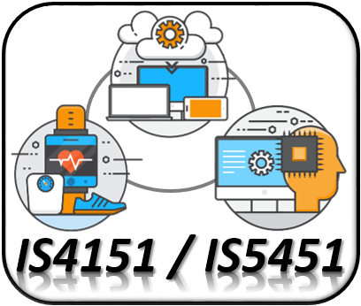
Single-board Computer (II) IS4151/IS5451 – AIoT Solutions and Development AY 2024/25 Semester 2
7
Lecture
Lecturer: A/P TAN Wee Kek
Email: tanwk@comp.nus.edu.sg :: Tel: 6516 6731 :: Office: COM3-02-35
Consultation: Tuesday, 2 pm to 4 pm. Additional consultations by appointment are welcome.

Slide 2

Quick Recap…
In the previous lecture, we learnt:
The technical characteristics of the Raspberry Pi.
Some additional concepts on basic electronics.
How to perform GPIO programming with the Raspberry PI using both digital and analogue signal.
RPi is a very capable single-board computer that can play a bigger role beyond a node device.
This lecture continues our learning journey to extend the role of RPi to a hub.
IoT Development
AI Machine Learning
Single-board Microcontroller
Single-board Computer
IoT Backend Integration
Android Development for IoT
IoT Data Preprocessing
Machine Learning for IoT Data
Computer Vision for IoT
IoT Architecture, Design and Protocols
Pervasive Computing
Technical Concepts
Introduction to Artificial Intelligence of Things

Slide 3

Learning Objectives
At the end of this lecture, you should understand:
BLE communication with Raspberry Pi.
Using Raspberry Pi to control micro:bit devices with BLE and radio.
Working with Raspberry Pi’s interfaces.
IoT Development
AI Machine Learning
Single-board Microcontroller
Single-board Computer
IoT Backend Integration
Android Development for IoT
IoT Data Preprocessing
Machine Learning for IoT Data
Computer Vision for IoT
IoT Architecture, Design and Protocols
Pervasive Computing
Technical Concepts
Introduction to Artificial Intelligence of Things

Slide 4

Readings
Required readings:
None.
Suggested readings:
None.

Slide 5

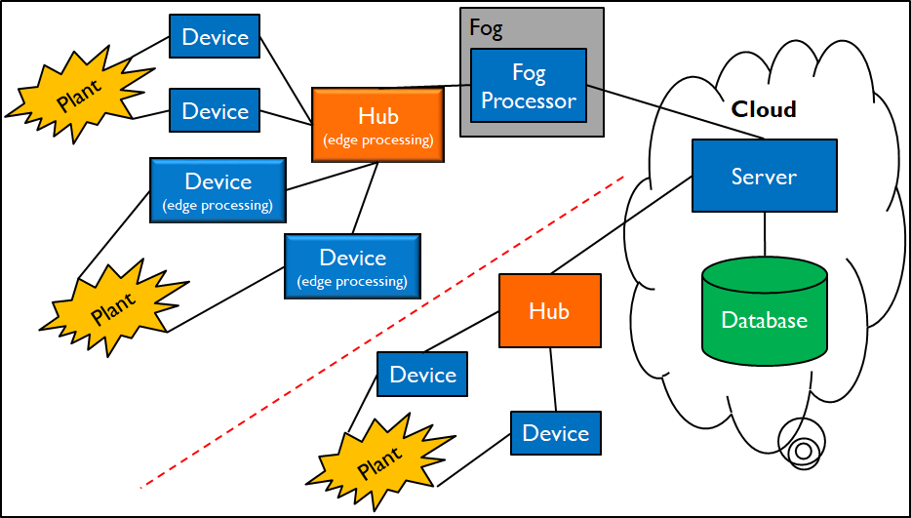
Technical Roadmap for IS4151/IS5451
Single-board Microcontroller
Android Wear
Single-board Computer
Android App
Server-side Backend Integration
AI & ML

Slide 6
Computational Capability of Raspberry Pi
The Raspberry Pi is single-board computer:
3 Model B is the third-generation model with wireless LAN and Bluetooth connectivity:
Quad Core 1.2GHz Broadcom BCM2837 64bit CPU
1GB RAM
The latest model is the 5 Model:
Quad Core 2.4GHz Broadcom BCM2712 64bit CPU
Up to 16GB RAM
Just how powerful is the Raspberry Pi 3 Model B relative to a conventional computer?
A comparison with my laptop, i.e., Lenovo ThinkPad X1 Extreme:
Hexa Core 2.70GHz Intel Core i7-10850H with vPro (12 Threads)
16 GB RAM

Slide 7
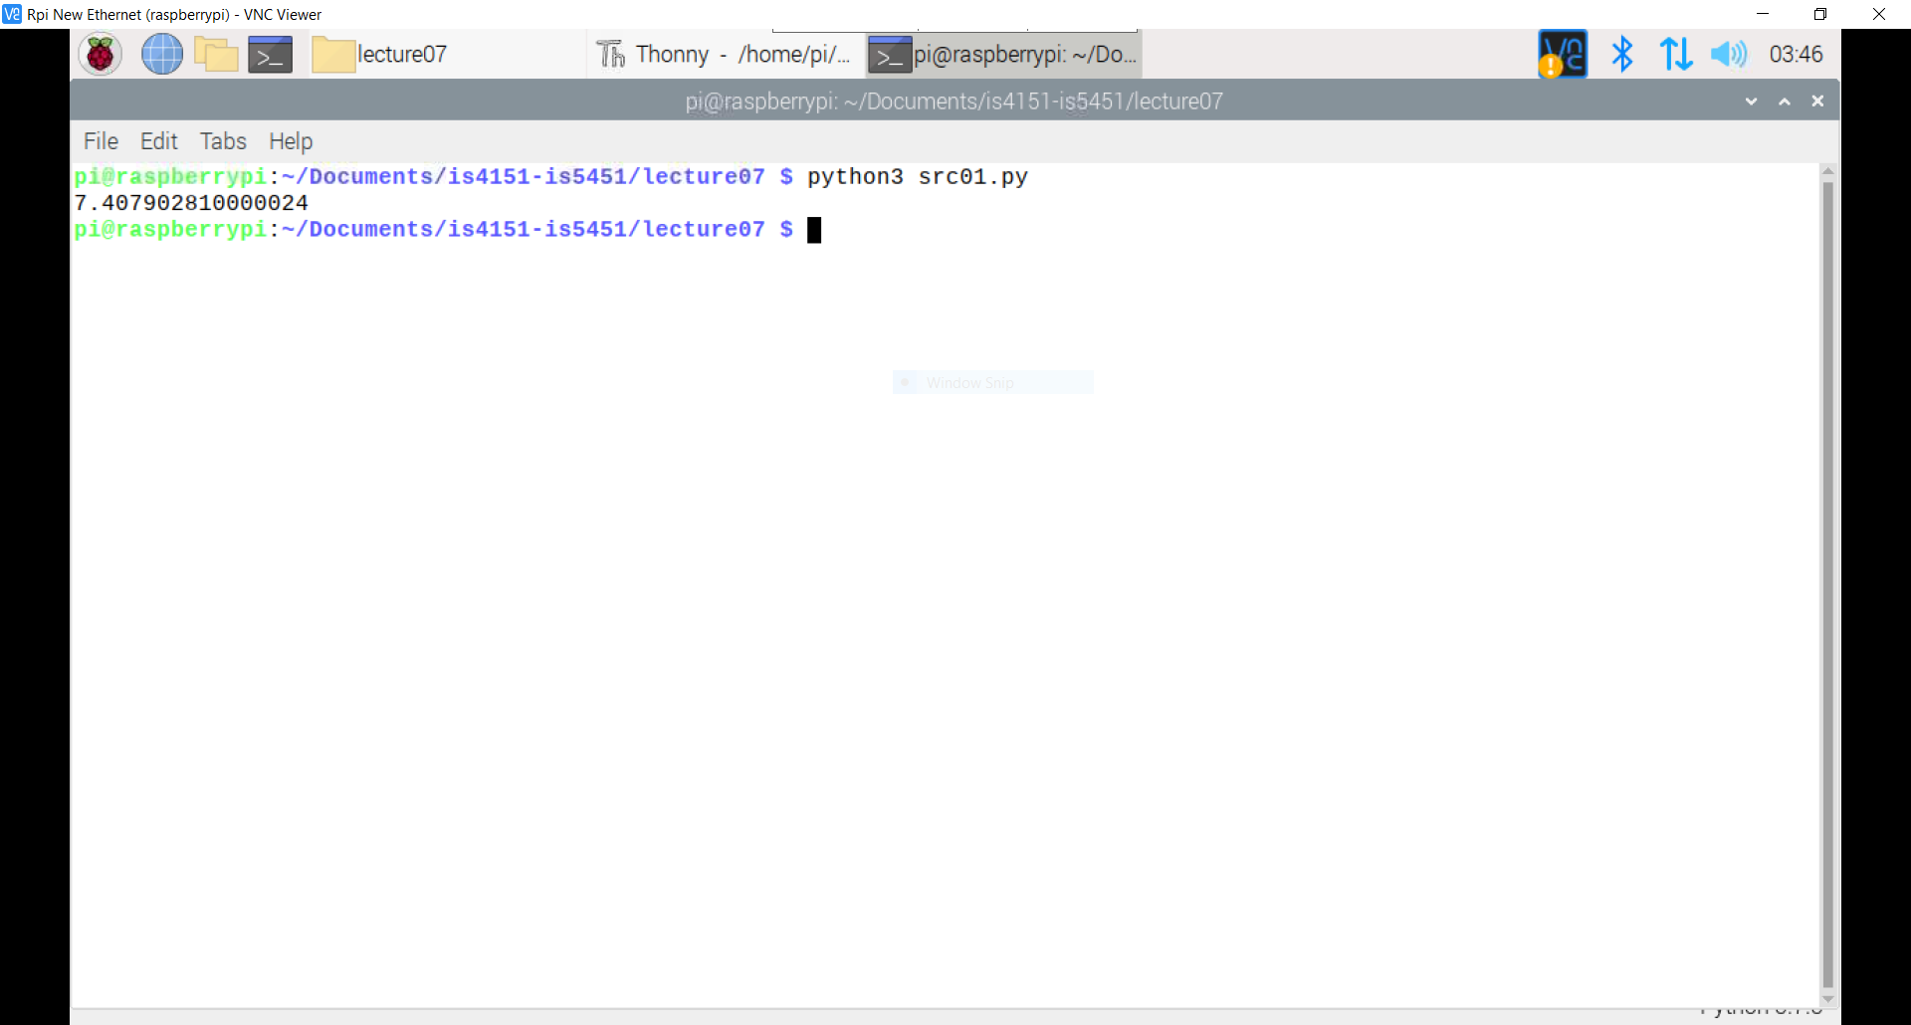
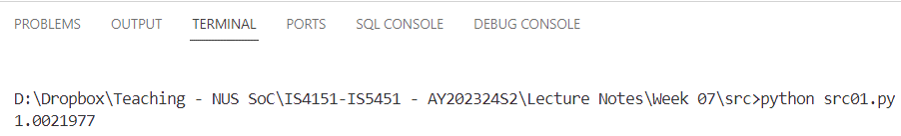
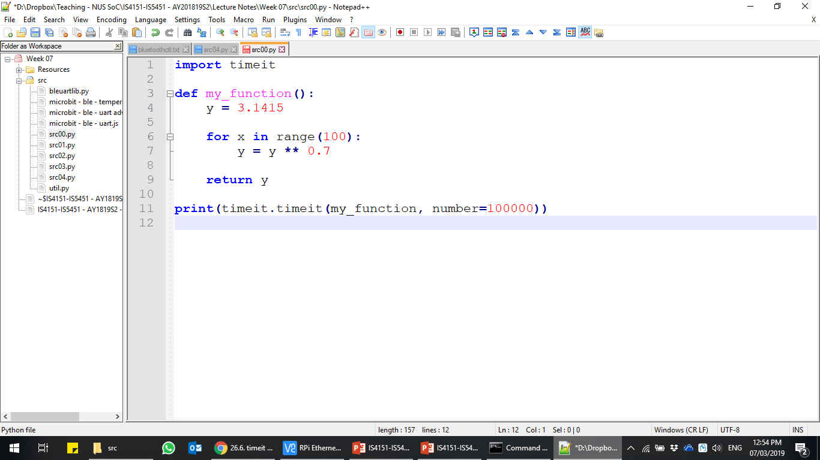
Computational Capability of Raspberry Pi (cont.)
We can use Python’s timeit module to measure the execution time of a small code snippet on both my laptop and a 3 Model B:
The execution time on the Raspberry Pi is about 7x slower.
That is quite impressive given that the Raspberry Pi is about 60x cheaper.
src01.py

Slide 8
Computational Capability of Raspberry Pi (cont.)
The Raspberry Pi is capable of acting as a hub and fog processor:
Sufficient processing power, memory and secondary storage.
Onboard support for WiFi and Bluetooth Low Energy (BLE).
Recall that edge computing and fog computing:
Transfer computation to a more computationally capable and Internet-enabled device that is geographically closer to the edge than to the cloud.
Makes it possible to build local views of data flows.
Aggregates data to be sent to the cloud for further offline analysis.

Slide 9
Computational Capability of Raspberry Pi (cont.)
In this lecture, we will discuss how to program the Raspberry Pi to act as a hub.
In the next lecture, we will learn how to program the Raspberry Pi to act as a fog processor.

Slide 10
Working with the Bluetooth Low Energy Stack on Raspberry Pi

Slide 11
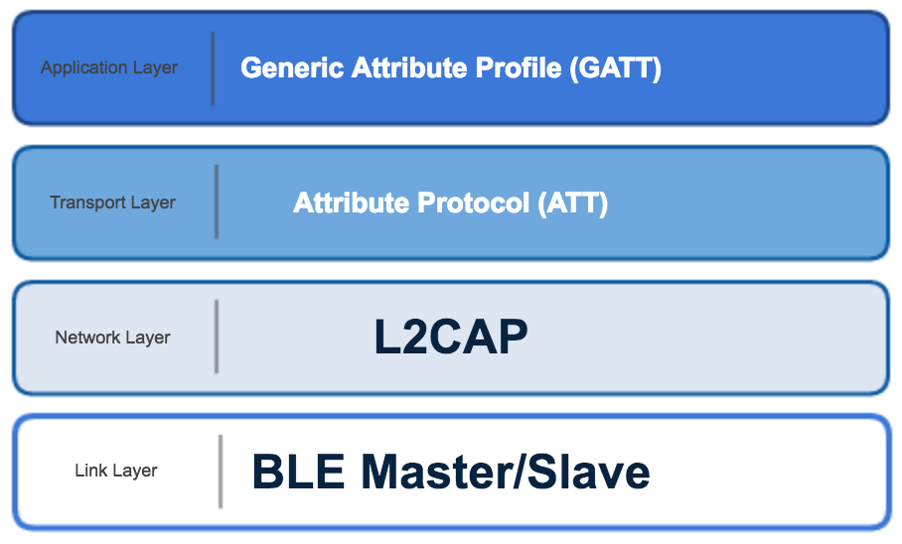
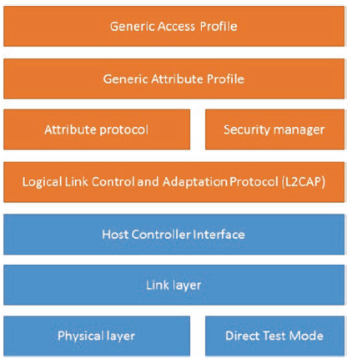
Quick Recap on BLE…
Recall that Bluetooth Low Energy (BLE):
Is a part of the Bluetooth standard designed for low-power operation such as devices powered from coin cell batteries.
A BLE device can work as a transmitter, receiver, or both.
The transport layer and network layer of BLE is independent of TCP/IP unlike MQTT:
Application Layer
Transport Layer
Network Layer

Slide 12
Quick Recap on BLE… (cont.)
Generic Access Profile (GAP) controls connections and advertising among BLE devices.
Generic Attributes Profile (GATT) defines a hierarchical data structure that is exposed to connected BLE devices.
GATT uses Attribute Protocol (ATT) to send and receive messages.

Slide 13
Generic Access Profile (GAP)
The GAP layer of the BLE protocol stack is responsible for connection functionality.
This layer handles the access modes and procedures of the device including:
Device discovery.
Link establishment.
Link termination.
Initiation of security features.
Device configuration.
Based on the role for which the device is configured, the GAP state diagram on the next slide shows the states of the device.

Slide 14
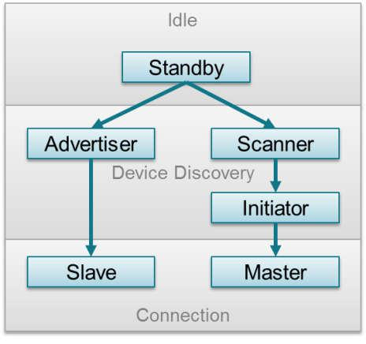
Generic Access Profile (GAP) (cont.)

Slide 15
Generic Access Profile (GAP) (cont.)
Standby:
The device is in the initial idle state upon reset.
Advertiser:
The device is advertising with specific data letting any scanning devices know that it is a connectible device.
This advertisement contains the device address and can contain some additional data such as the device name.
Scanner:
When receiving the advertisement, the scanning device sends a scan request to the advertiser.
The advertiser responds with a scan response.
This process is called device discovery.

Slide 16
Generic Access Profile (GAP) (cont.)
The scanning device is aware of the advertising device and can initiate a connection with it.
Initiator:
When initiating, the initiator must specify a peer device address to connect.
The initiating device sends out a request to establish a connection (link) with the advertising device together with the connection parameters.
Slave/Master:
When a connection (link) is formed, the advertiser device functions as a slave and the initiator device functions as a master.

Slide 17
BlueZ
On the Raspberry Pi OS, the implementation of the Bluetooth protocol stack is BlueZ:
BlueZ is the official Linux Bluetooth protocol stack.
Allows Raspberry Pi to communicate with Bluetooth classic and Bluetooth low energy (LE) device
More information about BlueZ – http://www.bluez.org/
Need to install the bluez and bluez-utils packages:
The bluez package provides the Bluetooth protocol stack.
The bluez-utils package provides the bluetoothctl utility tool.
Both packages should be installed by default:
May need to upgrade to the latest version.

Slide 18
BlueZ (cont.)
The bluetoothctl utility can be used to perform device discovery.
We will test with the micro:bit Bluetooth temperature service.
See microbit-ble-temperature.js.

Slide 19
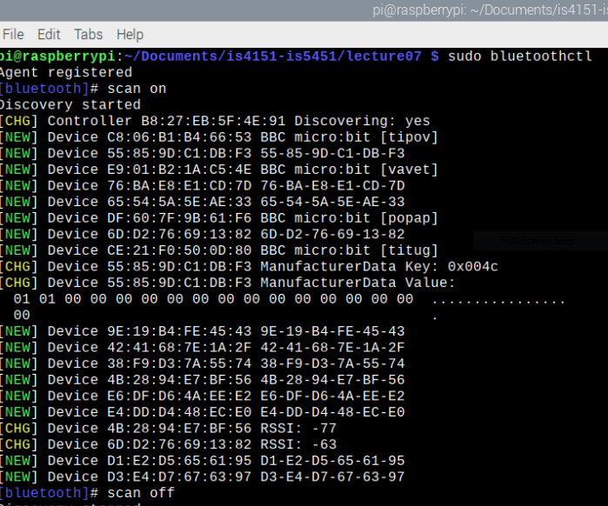
Bluetoothctl
Using bluetoothctl to perform device scanning and discovery:
sudo bluetoothctl

Slide 20
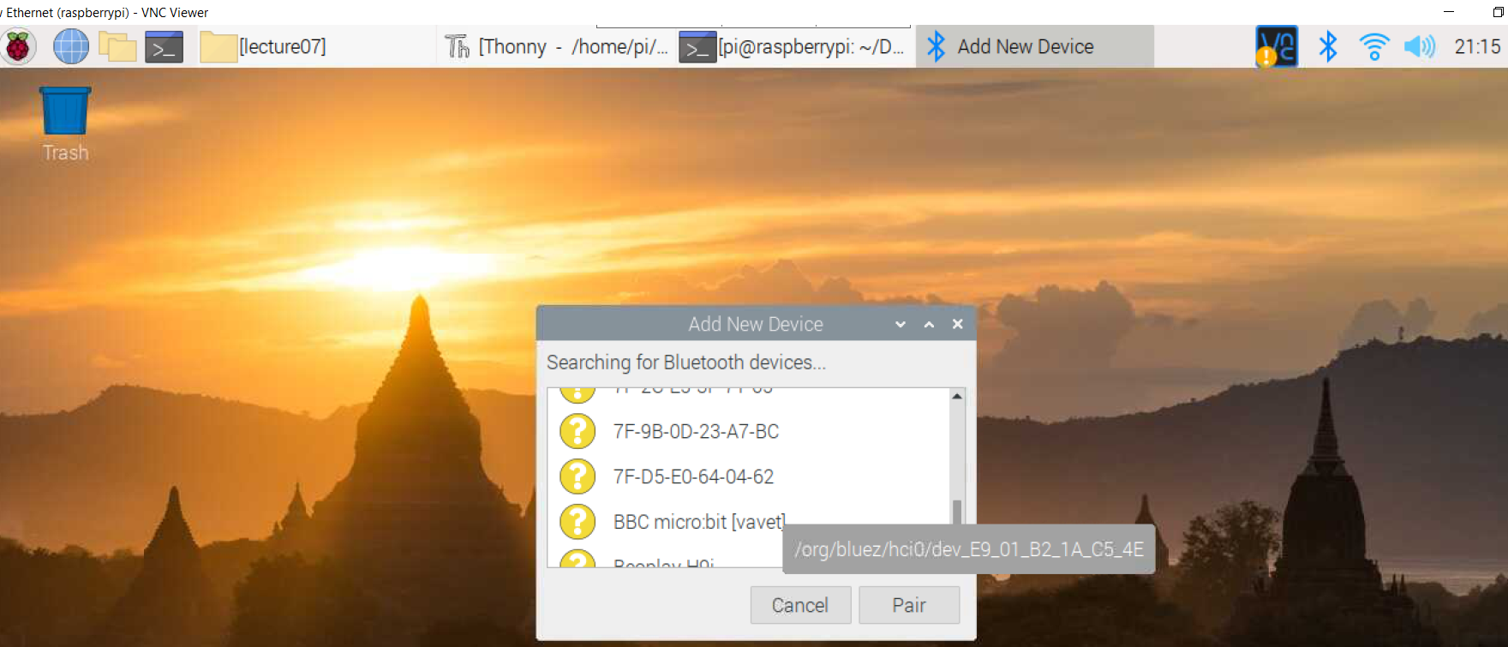
Bluetoothctl (cont.)
If you are unable to identify your micro:bit device in the scan results by name:
Goto “Manage Bluetooth devices”
Select “Add New Device”

Slide 21
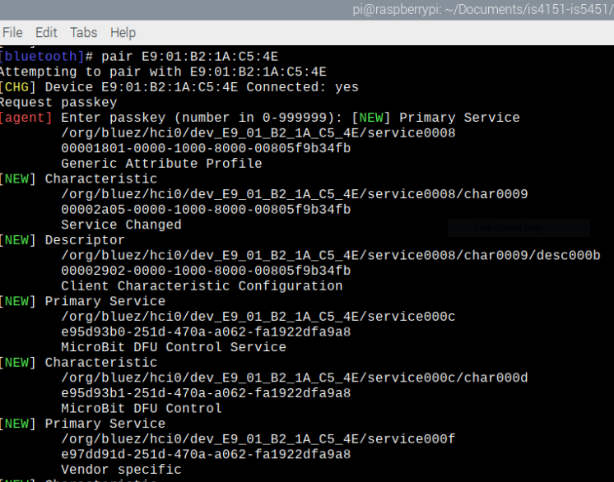
Bluetoothctl (cont.)

Slide 22
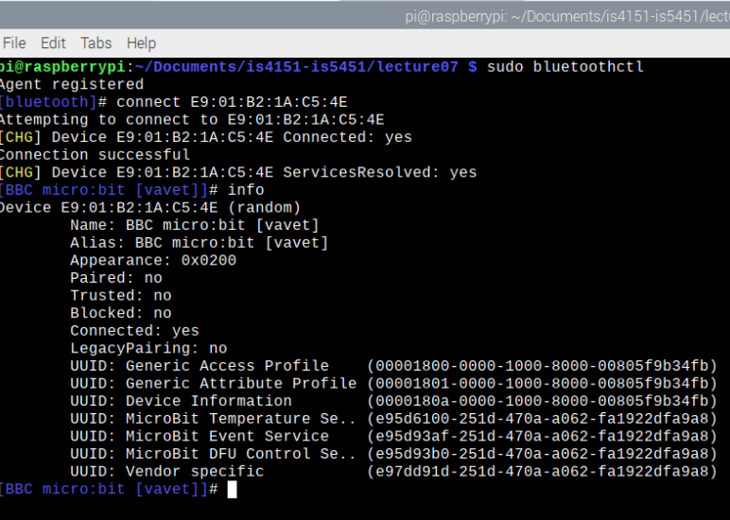
Bluetoothctl (cont.)
e95d6100-251d-470a-a062-fa1922dfa9a8 refers to the micro:bit Bluetooth temperature service.

Slide 23
Generic Attributes Profile (GATT)
GATT establishes in detail how to exchange all profile and user data over a BLE connection:
GAP defines the low-level interactions with devices.
In contrast, GATT only deals with actual data transfer procedures and formats.
GATT also provides the reference framework for all GATT-based profiles:
Profiles cover precise use cases and ensure interoperability between devices from different vendors.
All standard BLE profiles are therefore based on GATT and must comply with it to operate correctly.

Slide 24
Generic Attributes Profile (GATT) (cont.)
GATT uses ATT as its transport protocol to exchange data between devices.
The data is organized hierarchically into top-level sections called services.
Each service groups conceptually related pieces of user data called characteristics.
Characteristic:
A characteristic consists of a type (represented by a UUID), a value, a set of properties or attributes indicating the operations the characteristic supports.
It may also include one or more descriptors – metadata or configuration flags – relating to the owning characteristic.

Slide 25
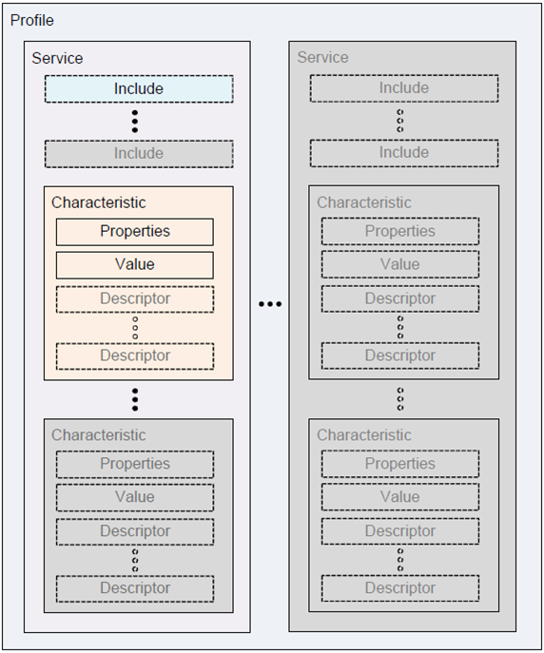
Generic Attributes Profile (GATT) (cont.)

Slide 26
Generic Attributes Profile (GATT) (cont.)
GATT server:
It receives requests from a client and sends responses back.
It also sends server-initiated updates when configured to do so.
It is responsible for storing and making the user data available to the client, organized in attributes.
Every BLE device must include at least a basic GATT server that can respond to client requests, even if only to return an error response.
GATT client:
It sends requests to a server and receives responses (and server-initiated updates) from it.
The GATT client does not know anything in advance about the server’s attributes.

Slide 27
Generic Attributes Profile (GATT) (cont.)
Must first inquire about the presence and nature of those attributes by performing service discovery.
After completing service discovery, it can then start reading and writing attributes found in the server, as well as receiving server-initiated updates.
Properties or attributes:
Properties or attributes are the smallest data entity defined by GATT (and ATT).
They are addressable pieces of information that can contain relevant user data (or metadata).
The attribute handle is a unique 16-bit identifier for each attribute on a particular GATT server.

Slide 28
Generic Attributes Profile (GATT) (cont.)
It is the part of each attribute that makes it addressable, and it is guaranteed not to change.
The attribute type is nothing other than a UUID, i.e., universally unique identifier.

Slide 29
Gattlib
Gattlib is the library that is used to access GATT information from BLE (Bluetooth Low Energy) devices.
Installation of the bluetooth and bluez libraries on the Raspberry Pi will install gattlib.
Use the gatttool utility to query a GATT server.

Slide 30
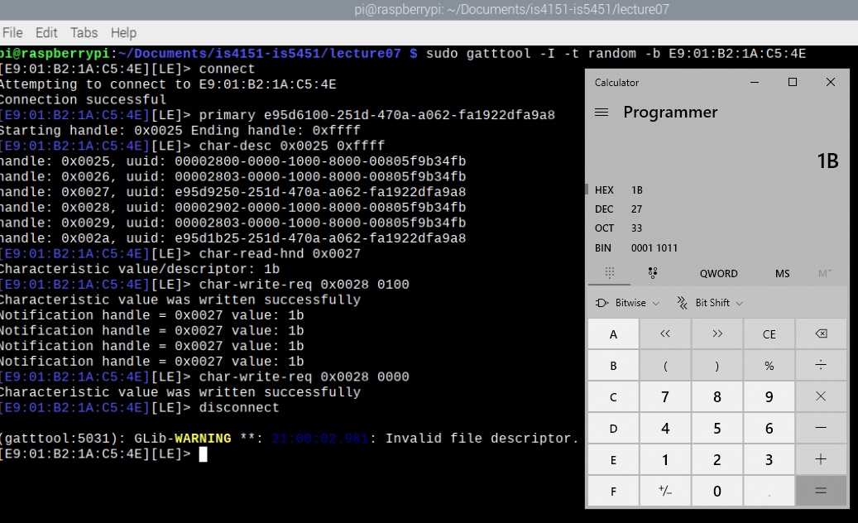
Gatttool
Using gatttool to connect to micro:bit:
e95d9250-251d-470a-a062-fa1922dfa9a8 refers to the micro:bit Bluetooth temperature service’s temperature value.

Slide 31
Working with Micro:bit Bluetooth Services

Slide 32
Quick Recap on micro:bit BLE…
Recall that micro:bit supports wireless connectivity via Bluetooth and Radio:
Specifically, Bluetooth Low Energy (BLE) is used for communication with other non-micro:bit devices.
A device such as a Raspberry Pi or smartphone can use any of the Bluetooth “services” provided by a micro:bit:
In general, device needs to be paired with micro:bit first.
However, we can configure micro:bit to operate in “no pairing required” mode such that any device can connect directly.
Once paired and connected, the device can exchange data relating to many of the micro:bit’s features.
Data exchange is enabled via various Bluetooth services.

Slide 33
Bluetooth Temperature Service
A micro:bit is able to provide a rough measure of the current environmental temperature in degrees celsius:
The approximate temperature value is inferred from the temperature of its main processor.
The Bluetooth temperature service allows another device to wirelessly:
Query the micro:bit’s current temperature reading.
Receive a constant stream of temperature data values.
This service allows any device to function as a graphical thermometer using micro:bit as the sensor.
No additional code is needed on the micro:bit to use the Bluetooth temperature service from another device.

Slide 34
Bluetooth Temperature Service (cont.)
Service parameters:
Type | UUID | Description
Primary Service | e95d6100-251d-470a-a062-fa1922dfa9a8 | Temperature Service
Descriptor | 00002902-0000-1000-8000-00805f9b34fb | Client Characteristic Configuration
Characteristic | e95d9250-251d-470a-a062-fa1922dfa9a8 | Temperature Value
Characteristic | e95d1b25-251d-470a-a062-fa1922dfa9a8 | Temperature Period

Slide 35
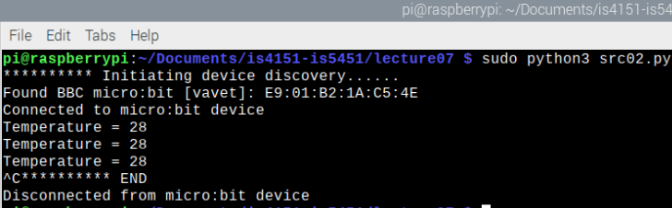
Bluetooth Temperature Service (cont.)
Reading temperature manually at periodic interval from one micro:bit device:
See sample source file src02.py

Slide 36
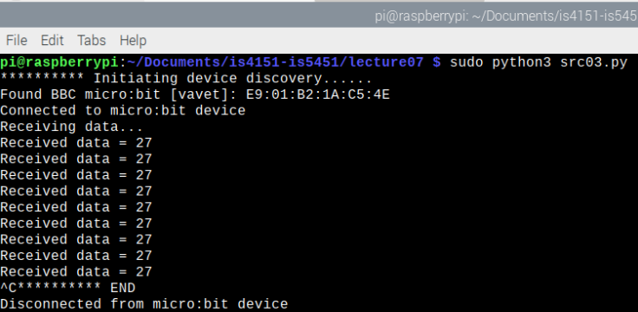
Bluetooth Temperature Service (cont.)
Subscribing to auto-update of temperature from one micro:bit device:
See sample source file src03.py

Slide 37
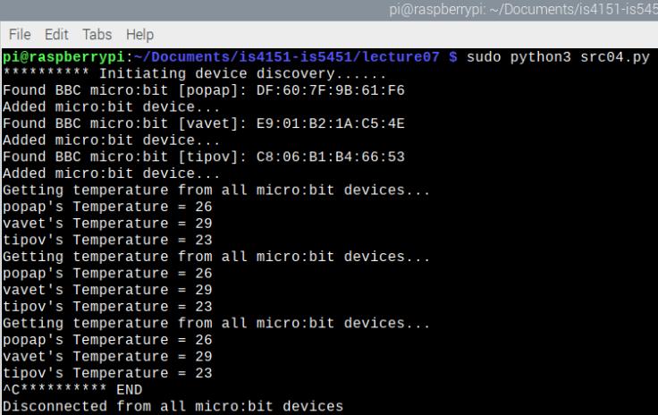
Bluetooth Temperature Service (cont.)
Reading temperature manually at periodic interval from multiple micro:bit devices:
See sample source file src04.py

Slide 38
Bluetooth Magnetometer Service
Micro:bit’s magnetometer:
Measures the strength and direction of magnetic fields.
It can be used as a digital compass and indicate the way the micro:bit is pointing relative to the magnetic north.
The Bluetooth magnetometer service allows another device to wirelessly receive data from the micro:bit’s magnetometer.
This service allows a device or application to display the direction of travel with real-time updates.

Slide 39
Bluetooth Magnetometer Service (cont.)
Service parameters:
Type | UUID | Description
Primary Service | e95df2d8-251d-470a-a062-fa1922dfa9a8 | Magnetometer Service
Descriptor | 00002902-0000-1000-8000-00805f9b34fb | Client Characteristic Configuration
Characteristic | e95db358-251d-470a-a062-fa1922dfa9a8 | Calibrate
Characteristic | e95d9715-251d-470a-a062-fa1922dfa9a8 | Bearing
Characteristic | e95dfb11-251d-470a-a062-fa1922dfa9a8 | Raw Sensor Values (X, Y, Z)

Slide 40
Bluetooth UART Service
The Bluetooth UART service allows another device to exchange any data it wants to with the micro:bit:
Data exchanges are done in small chunks.
The data are intended to be joined together before further processing.
More about UART:
UART stands for Universal Asynchronous Receiver Transmitter.
It is used to perform serial data communications usually between two devices connected by a physical, wired connection.
The Bluetooth UART service emulates the behaviour of a physical UART system.

Slide 41
Bluetooth UART Service (cont.)
Bluetooth UART allows the exchange of a maximum of 20 bytes of data at a time in either direction.
When the Bluetooth UART service is in-use:
Micro:bit sets up a 60-byte buffer and data it receives will be accumulated in the buffer until it is full.
We can indicate a special character which will be used to indicate that the entire message in at most three chunks has now been sent by the other connected device.
At this point, micro:bit will release the entire contents of its buffer to any code trying to read it.
The special character is known as the “delimiter”.

Slide 42
Bluetooth UART Service (cont.)
The Bluetooth UART service can be used for many use cases because the messages can contain “anything”.
Unlike most other Bluetooth services such as temperature and magnetometer, the UART service requires additional micro:bit code:
For detecting the connection state of the other device.
For reading and using data from the UART buffer.
For writing data to the UART buffer for transmission to another device.

Slide 43
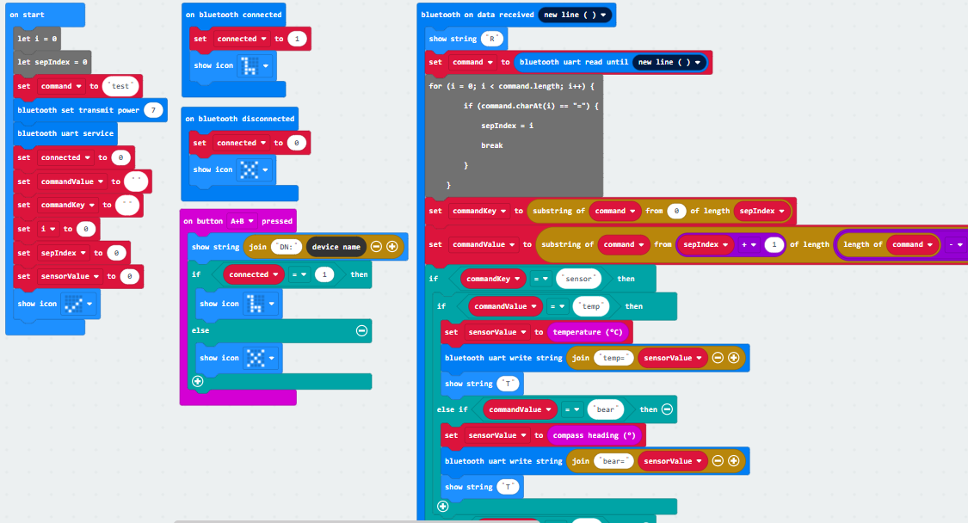
Bluetooth UART Service (cont.)
microbit-ble-uart-advanced.js

Slide 44
Bluetooth UART Service (cont.)
Service parameters:
Type | UUID | Description
Primary Service | 6e400001-b5a3-f393-e0a9-e50e24dcca9e | UART Service
Descriptor | 00002902-0000-1000-8000-00805f9b34fb | Client Characteristic Configuration
Characteristic | 6e400002-b5a3-f393-e0a9-e50e24dcca9e | UART TX
Characteristic | 6e400003-b5a3-f393-e0a9-e50e24dcca9e | UART RX

Slide 45

Bluetooth UART Service (cont.)
Subscribing to auto-update of UART data from one micro:bit device:
See sample source files microbit-ble-uart.js and src05.py

Slide 46
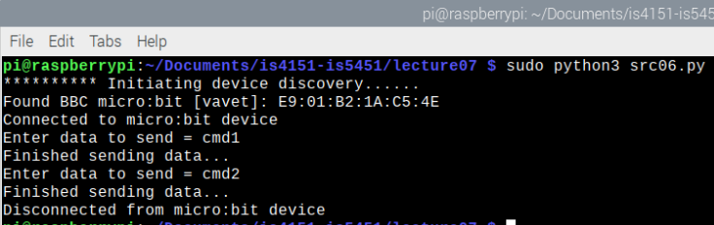
Bluetooth UART Service (cont.)
Sending UART data manually to one micro:bit device:
See sample source file src06.py

Slide 47
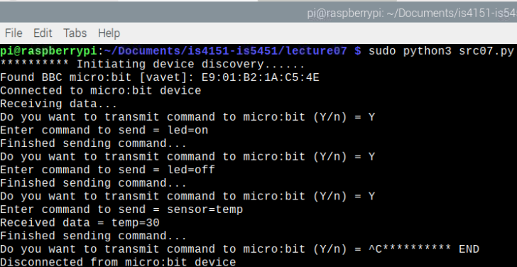
Bluetooth UART Service (cont.)
Sending and receiving UART data manually to/from one micro:bit device:
See sample source files microbit-ble-uart-advanced.js and src07.py

Slide 48
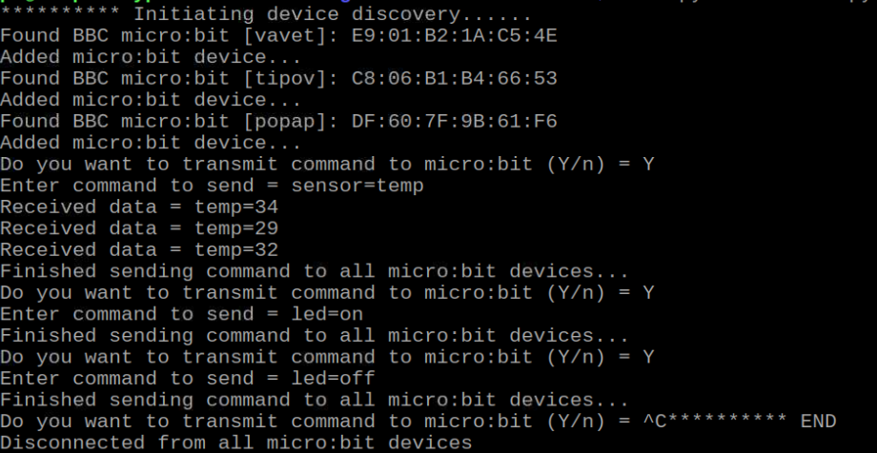
Bluetooth UART Service (cont.)
Sending and receiving UART data manually to/from multiple micro:bit devices:
See sample source file src08.py

Slide 49
Bluetooth UART Service (cont.)
The preceding example in sample source file src08.py demonstrates one approach for a Raspberry Pi to:
Act as a hub.
Control and interact with multiple micro:bit devices via BLE:
Micro:bit 1
BLE
Micro:bit 2
BLE
Raspberry Pi
BLE
Micro:bit 3
BLE
Micro:bit n

Slide 50
Working with Raspberry Pi’s Interfaces

Slide 51
Quick Recap on Raspberry Pi Interfaces…
Recall that Raspberry Pi is a single-board computer as compared to the micro:bit, which is a microcontroller:
Raspberry Pi has a set of proper interfaces in addition to the GPIO pins.
These interfaces include:
4 USB 2 ports, with switched Micro USB power source up to 2.5A.
4 Pole stereo output and composite video port.
Full size HDMI.
CSI camera and DSI display port for connecting a Raspberry Pi camera and touchscreen display, respectively.
Also recall that Raspberry Pi runs on a full-fledged operating system, another major differentiation factor from a microcontroller.

Slide 52
Quick Recap on Raspberry Pi Interfaces… (cont.)
These interfaces and the operating system enable us to implement additional use cases that strengthen the role of Raspberry Pi as a hub and fog processor.

Slide 53
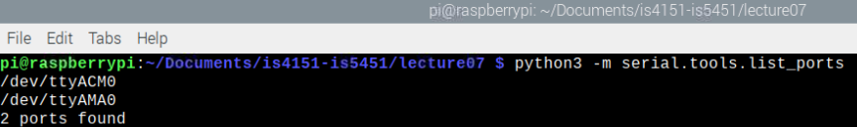
Serial Communication Over USB
Recall that micro:bit supports reading and writing data over a serial connection.
By default, micro:bit is set to use the USB connection for serial data:
When micro:bit is connected to a Raspberry Pi, it will appear as a new serial port to the Raspberry PI OS, e.g., /dev/ttyACM0
The pySerial module can be used to check the available serial ports on a Raspberry Pi:
python3 -m serial.tools.list_ports

Slide 54
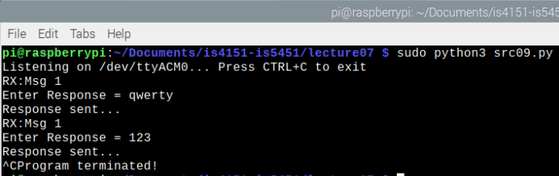
Serial Communication Over USB (cont.)
We can use pySerial to communicate with another micro:bit device easily over USB instead of GPIO:
See sample source file microbit-serial-over-usb-basic.js and src09.py

Slide 55
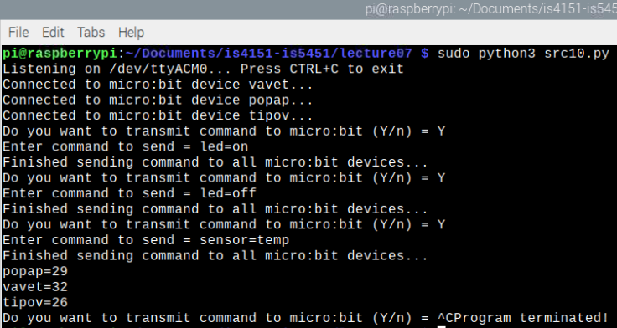
Serial Communication Over USB (cont.)
The micro:bit device can then communicate with other micro:bit devices using radio wireless communication:
See sample source file src10.py

Slide 56
Serial Communication Over USB (cont.)
The preceding example in sample source file src10.py demonstrates another approach for a Raspberry Pi to:
Act as a hub.
Control and interact with multiple micro:bit devices via one wired controller and radio:
Micro:bit 1
Radio
Micro:bit 2
Radio
Raspberry Pi
Micro:bit Controller
Radio
Micro:bit 3
Radio
Micro:bit n

Slide 57
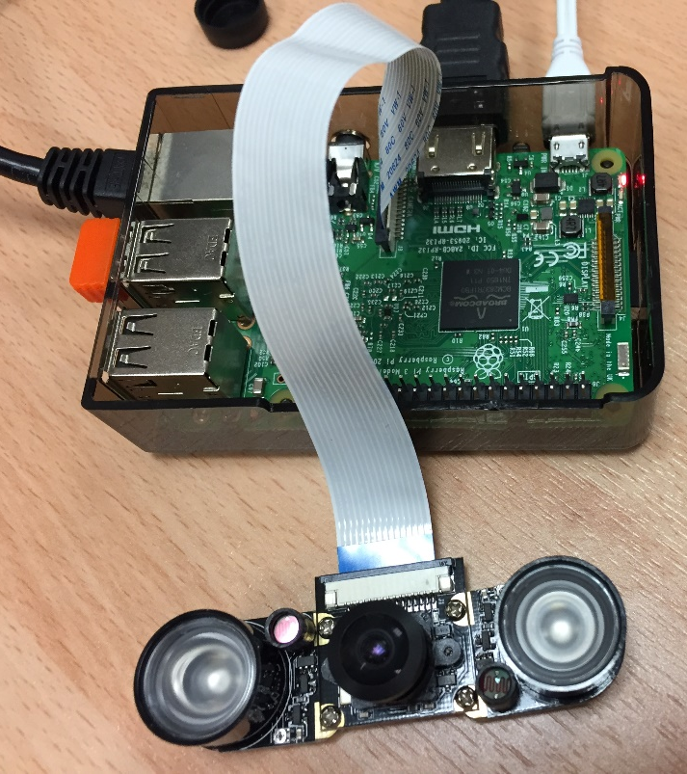
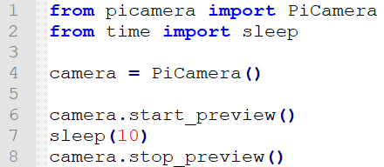
Raspberry Pi Camera
The Raspberry Pi camera together with Python’s picamera module allows the device to take still pictures, record video, and apply image effects:
Camera preview only works when a monitor is connected to the Raspberry Pi.
Remote access (such as SSH and VNC) will not allow you to see the camera preview.
src11.py

Slide 58
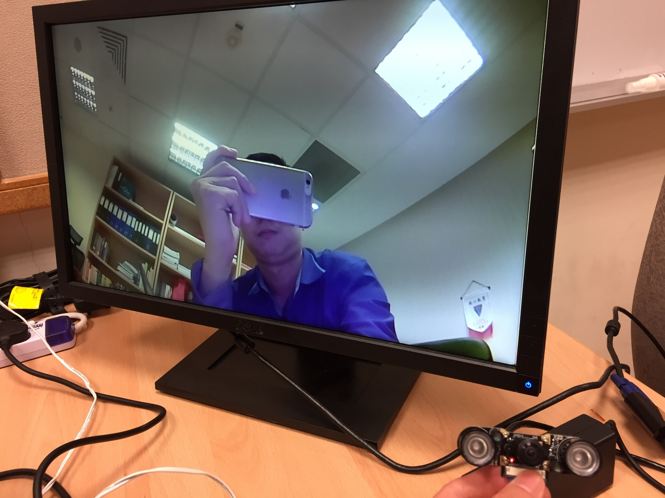
Raspberry Pi Camera (cont.)

Slide 60
Raspberry Pi Camera (cont.)
The most common use case for the camera is taking still pictures:
The image files can be stored locally or transmitted to a cloud server.
Need to sleep for at least 2 seconds before capturing, to give the sensor time to set its light levels.
See sample source file src12.py
We can also record video easily:
Image and video recording can be combined with other suitable sensors, e.g., PIR motion sensor, as well as data analytics to implement advanced use cases.
See sample source file src13.py

Slide 61
Passive Infrared (PIR) Motion Sensor
PIR sensor is used to detect motion from human or other objects from about 6 meters away.
Working principle of PIR sensor:
The motion sensor consists of a fresnel lens, an infrared detector, and supporting detection circuitry.
The lens on the sensor focuses any infrared radiation present around it toward the infrared detector.
Our bodies generate infrared heat, and as a result, this heat is picked up by the motion sensor.
The sensor outputs a 5V signal for a period of time as soon as it detects the presence of a person.

Slide 62
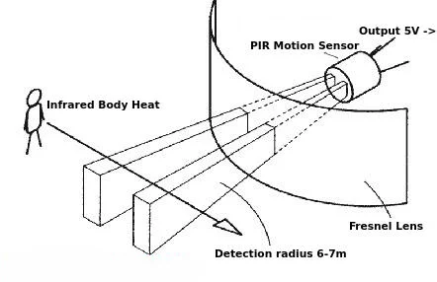
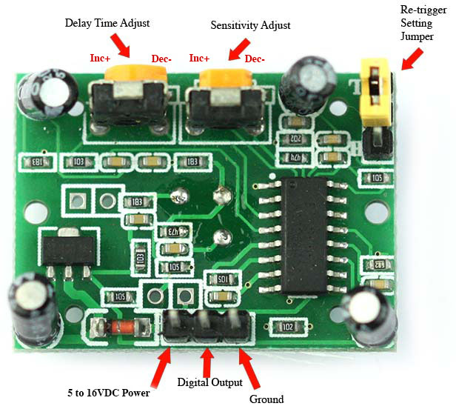
Passive Infrared (PIR) Motion Sensor (cont.)
The PIR sensor that we are using in this demonstration has an adjustable delay before firing (approximately 2-4 seconds) and adjustable sensitivity.

Slide 63
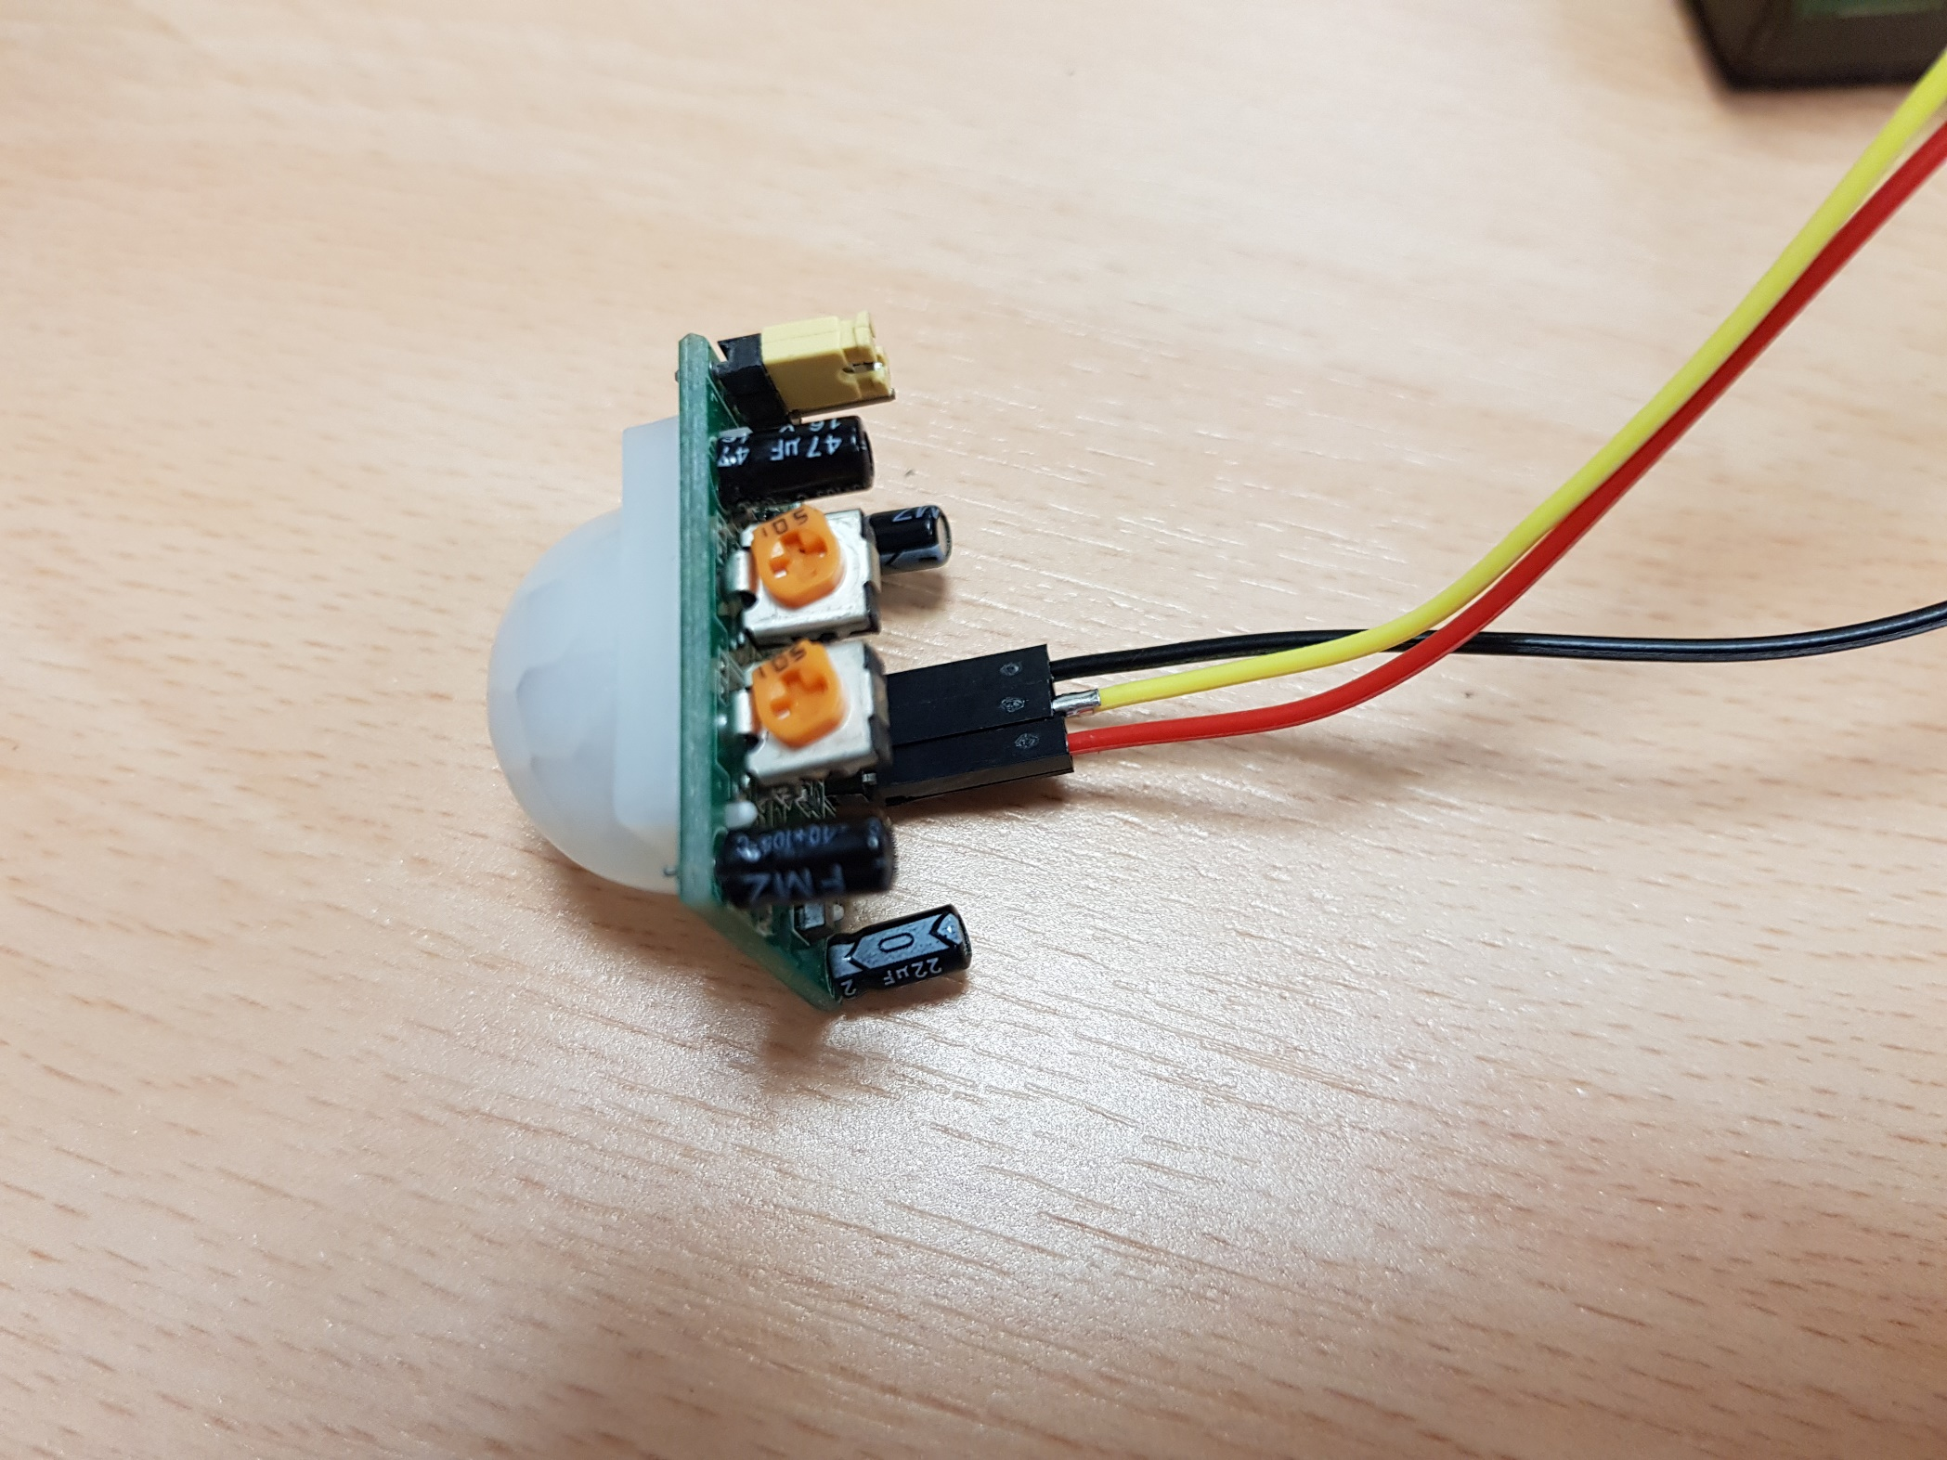
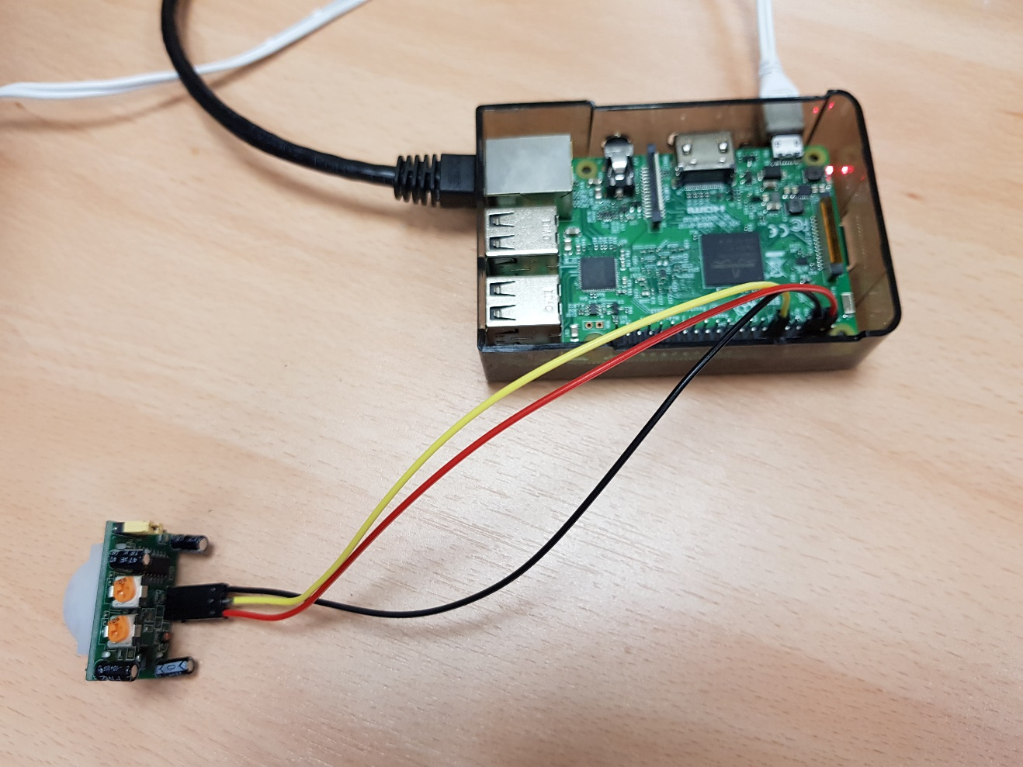
Passive Infrared (PIR) Motion Sensor (cont.)
The digital output pin of the PIR sensor in the circuit below is connected to GPIO pin 12.
See sample source file src14.py for a simple demonstration of detecting motion with the PIR sensor.
Digital output to Pin 12

Slide 64
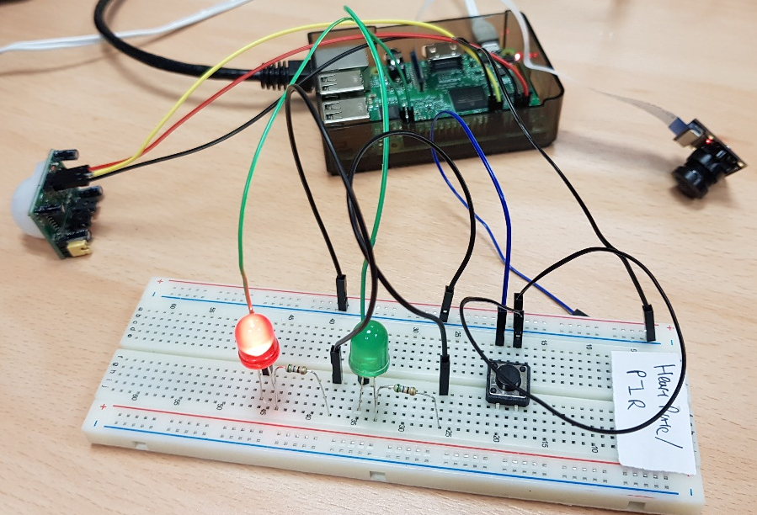
Security Camera
We can combine a PIR motion sensor with a Raspberry Pi camera module to create a simple security camera system:
Capture a still picture or record video when a motion is detected.
The picture or video can be emailed to user or uploaded to a cloud server.
See sample source file src15.py.

Slide 65

Summary
Micro:bit provides several Bluetooth services that allow an external device to interact with its sensors, buttons and even GPIO pins wirelessly.
Raspberry Pi has onboard support for Bluetooth Low Energy (BLE) wireless communication that allows it to interact with a micro:bit’s Bluetooth services.
Micro:bit’s Bluetooth UART service provides a flexible and powerful mechanism for a Raspberry Pi device to communicate with, and control, one or more micro:bit devices.

Slide 66

Q&A

Slide 67

Next Lecture…
Learn about:
What is Service-Oriented Architecture.
What is RESTful web service.
How to create RESTful web service in Python with Flask and Connexion.
How to test RESTful web service in Postman.
How to consume RESTful web service in Python.
Persisting the data to a relational database.
IoT Development
AI Machine Learning
Single-board Microcontroller
Single-board Computer
IoT Backend Integration
Android Development for IoT
IoT Data Preprocessing
Machine Learning for IoT Data
Computer Vision for IoT
IoT Architecture, Design and Protocols
Pervasive Computing
Technical Concepts
Introduction to Artificial Intelligence of Things

